Slide 1
Setting up Mautic in coolify
hosting mautic on your own open source paas

Slide 2



Who am i
Mautic World Conference 2025 @Sea Containers, London
1
Head of Data & Analytics @VML Germany
Freelance Jack of all Trades Marketing @moorwald
Team Lead Marketing Team @Mautic

Slide 3


Behind The Case
Mautic World Conference 2025 @Sea Containers, London
2
Automated CSRD Certification SMEs get their ESG certificate through online questionnaire instead of weeks of consulting
Helping with Compliance Pressure in B2B Supply Chain Suppliers to large corporations increasingly need ESG proof, same applies for public tenders and bank communication
Certificate in <24h Certificate is immediately ready for download within minutes
Mautic as central marketing hub Newsletter campaigns, landing pages, marketing automation, and future whitepaper downloads run on Coolify
Transactional Emails via API Certificate downloads, registration confirmations, and password resets are sent directly from the application through Mautic API

Slide 4
An overly short overview of coolify
Mautic World Conference 2025 @Sea Containers, London
3
What it is
Problem it solves
Key features
Open-source, self-hostable Platform as a Service (PaaS)
Essentially an alternative to Heroku, Netlify, and Vercel
You run it on your own infrastructure, basically on any machine you can ssh into
Personally I host mine (and the client’s one) on Hetzner VPS for < 10€/Month
Eliminates expensive cloud PaaS bills
Eliminates vendor lock-in
Provides the same deployment convenience (as those proprietary cloud services)
Easily deploy apps, databases, and 280+ services to any server (or servers)
Git integration (GitHub, GitLab, Bitbucket)
Automatic SSL certificates
One-click database/service deployments
Works on any hardware - VPS, bare metal, Raspberry Pi, or cloud instances
No vendor lock-in - all configurations saved to your server

Slide 5
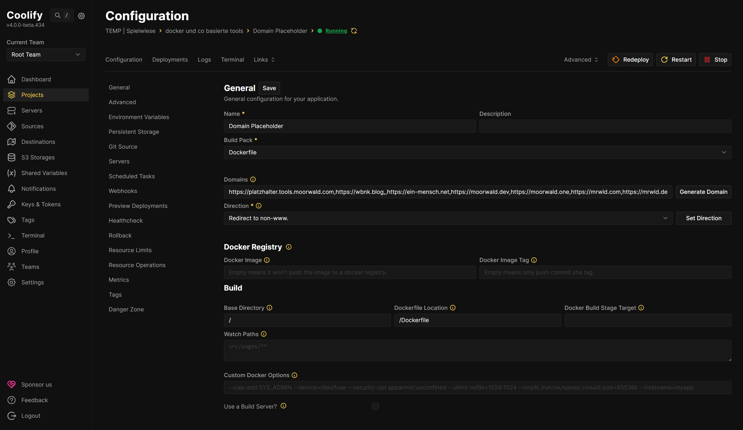
Why I like using it
Mautic World Conference 2025 @Sea Containers, London
4
Notifications Email + Pushover when things break or backups succeed
Wildcard setup *.tools subdomain + auto Let's Encrypt = deploy anything in minutes
15+ services running Mautic, Matomo, custom tools, monitoring, DBs, DNS - mail server next
Variables & secrets Per-project ENVs, shared secrets, team access, centralized token management
S3 backups Set once, forget about it
Scaling Quickly & easily add additional servers for additional services/projects, if the need arises

Slide 6
Avoiding The One Click Complexity
Mautic World Conference 2025 @Sea Containers, London
5
Or how I recovered from shoting myself in the foot.

Slide 7
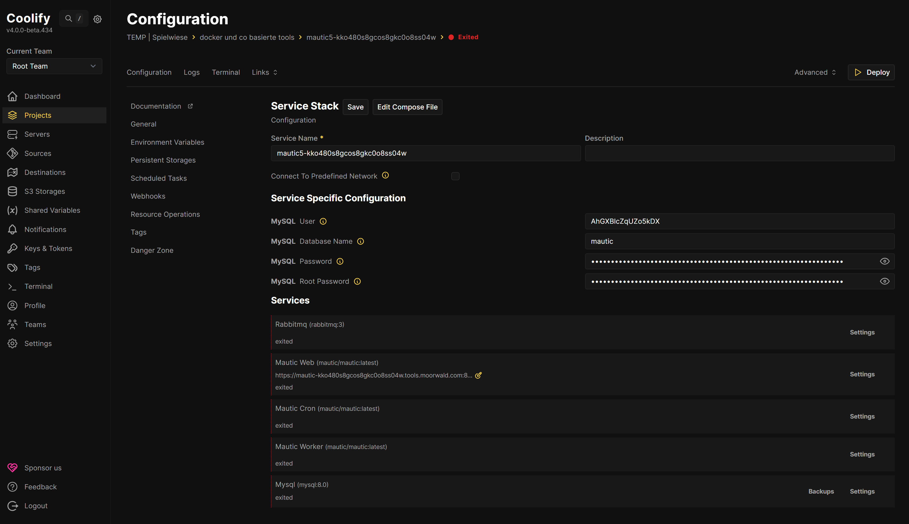
Quest for mordor
Mautic World Conference 2025 @Sea Containers, London
6
Two days of trying to get this to work Debugging Rabbitmq & Mautic
Throwing the towel Finally gave up, decided that I don‘t need queueing and that things must be easier
Using a Compose File Decided on a minimal docker compose setup of Mautic and MySQL*
Cronjobs via UI Coolify calls them „Scheduled Task“
Fit to scale My client does not have many thousands of contacts (hopefully) yet. We‘ll cross that bridge, when we get to it
Result Within 30 minutes I was running smoothly and had sent my first test mail via Mautic
* There‘s a slightly more robust solution at the end

Slide 8
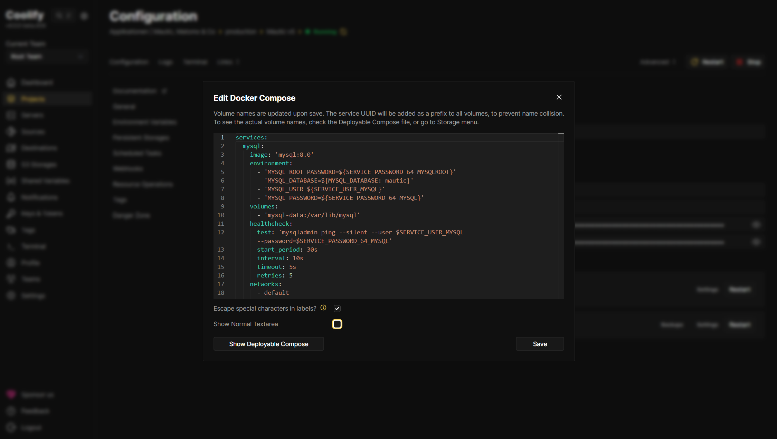
A more easy solution
Mautic World Conference 2025 @Sea Containers, London
7
services:
mysql:
image: 'mysql:8.0'
environment:
[[ A FEW ENV VARS]]
volumes:
- 'mysql-data:/var/lib/mysql'
healthcheck:
[[ healthcheck definition ]]
networks:
- default
- analytics-network
mautic_web:
image: 'mautic/mautic:latest'
volumes:
[[ A FEW VOLUMES ]]
environment:
[[ A FEW ENV VARS]]
healthcheck:
[[ healthcheck definition ]]
labels: [[ A FEW LABELS ]]
volumes:
mysql-data: null
mautic-dataconfig: null
mautic-datalogs: null
mautic-datamediafiles: null
mautic-datamediaimages: null
mautic-dataplugins: null
mautic-datathemes: null
mautic-datavendor: null
mautic-databin: null
networks:
analytics-network:
name: analytics-network
external: false

Slide 9
The Compose File in Detail: Mautic & MYSQL
mautic_web:
image: 'mautic/mautic:latest’
volumes:
- 'mautic-dataconfig:/var/www/html/config'
- 'mautic-datalogs:/var/www/html/var/logs'
- 'mautic-datamediafiles:/var/www/html/docroot/media/files'
- 'mautic-datamediaimages:/var/www/html/docroot/media/images'
- 'mautic-dataplugins:/var/www/html/docroot/plugins'
- 'mautic-datathemes:/var/www/html/docroot/themes'
- 'mautic-datavendor:/var/www/html/vendor'
- 'mautic-databin:/var/www/html/bin’
environment:
- SERVICE_FQDN_MAUTIC_80
- 'DOCKER_MAUTIC_LOAD_TEST_DATA=${MAUTIC_LOAD_TEST_DATA:-false}'
- 'DOCKER_MAUTIC_RUN_MIGRATIONS=${MAUTIC_RUN_MIGRATIONS:-false}'
- 'MAUTIC_DB_HOST=${MYSQL_HOST:-mysql}'
- 'MAUTIC_DB_PORT=${MYSQL_PORT:-3306}'
- 'MAUTIC_DB_DATABASE=${MYSQL_DATABASE:-mautic}'
- 'MAUTIC_DB_USER=${SERVICE_USER_MYSQL}'
- 'MAUTIC_DB_PASSWORD=${SERVICE_PASSWORD_64_MYSQL}'
- 'MAUTIC_MESSENGER_DSN_EMAIL=sync://'
- 'MAUTIC_MESSENGER_DSN_HIT=sync://’
healthcheck:
test:
- CMD
- curl
- '-f'
- 'http://localhost'
interval: 15s
timeout: 10s
retries: 15
labels:
- traefik.docker.network=r430kw5wofggs8c0oh4tc8so
mysql:
image: 'mysql:8.0'
environment:
- 'MYSQL_ROOT_PASSWORD=${SERVICE_PASSWORD_64_MYSQLROOT}'
- 'MYSQL_DATABASE=${MYSQL_DATABASE:-mautic}'
- 'MYSQL_USER=${SERVICE_USER_MYSQL}'
- 'MYSQL_PASSWORD=${SERVICE_PASSWORD_64_MYSQL}’
volumes:
- 'mysql-data:/var/lib/mysql’
healthcheck:
test: 'mysqladmin ping --silent --user=$SERVICE_USER_MYSQL --password=$SERVICE_PASSWORD_64_MYSQL'
start_period: 30s
interval: 10s
timeout: 5s
retries: 5
networks:
- default
- analytics-network
volumes:
mysql-data: null
mautic-dataconfig: null
mautic-datalogs: null
mautic-datamediafiles: null
mautic-datamediaimages: null
mautic-dataplugins: null
mautic-datathemes: null
mautic-datavendor: null
mautic-databin: null
networks:
analytics-network:
name: analytics-network
external: false

Slide 10
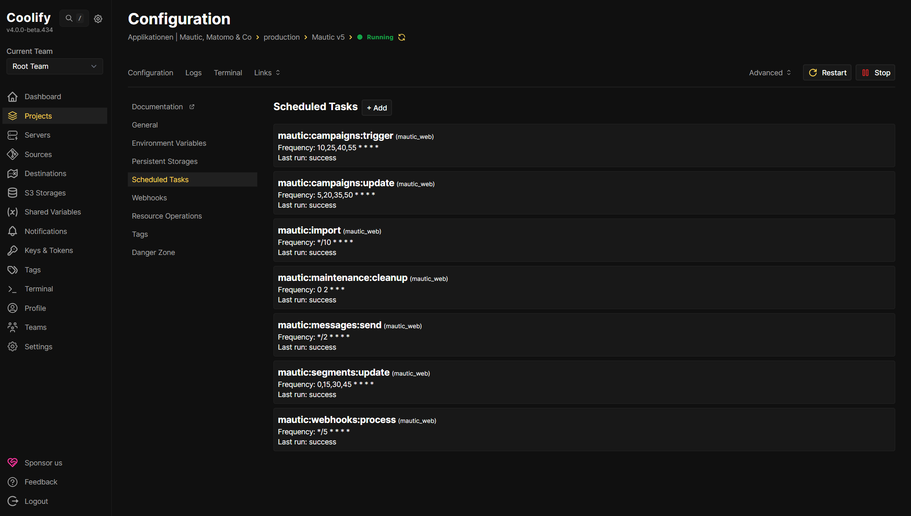
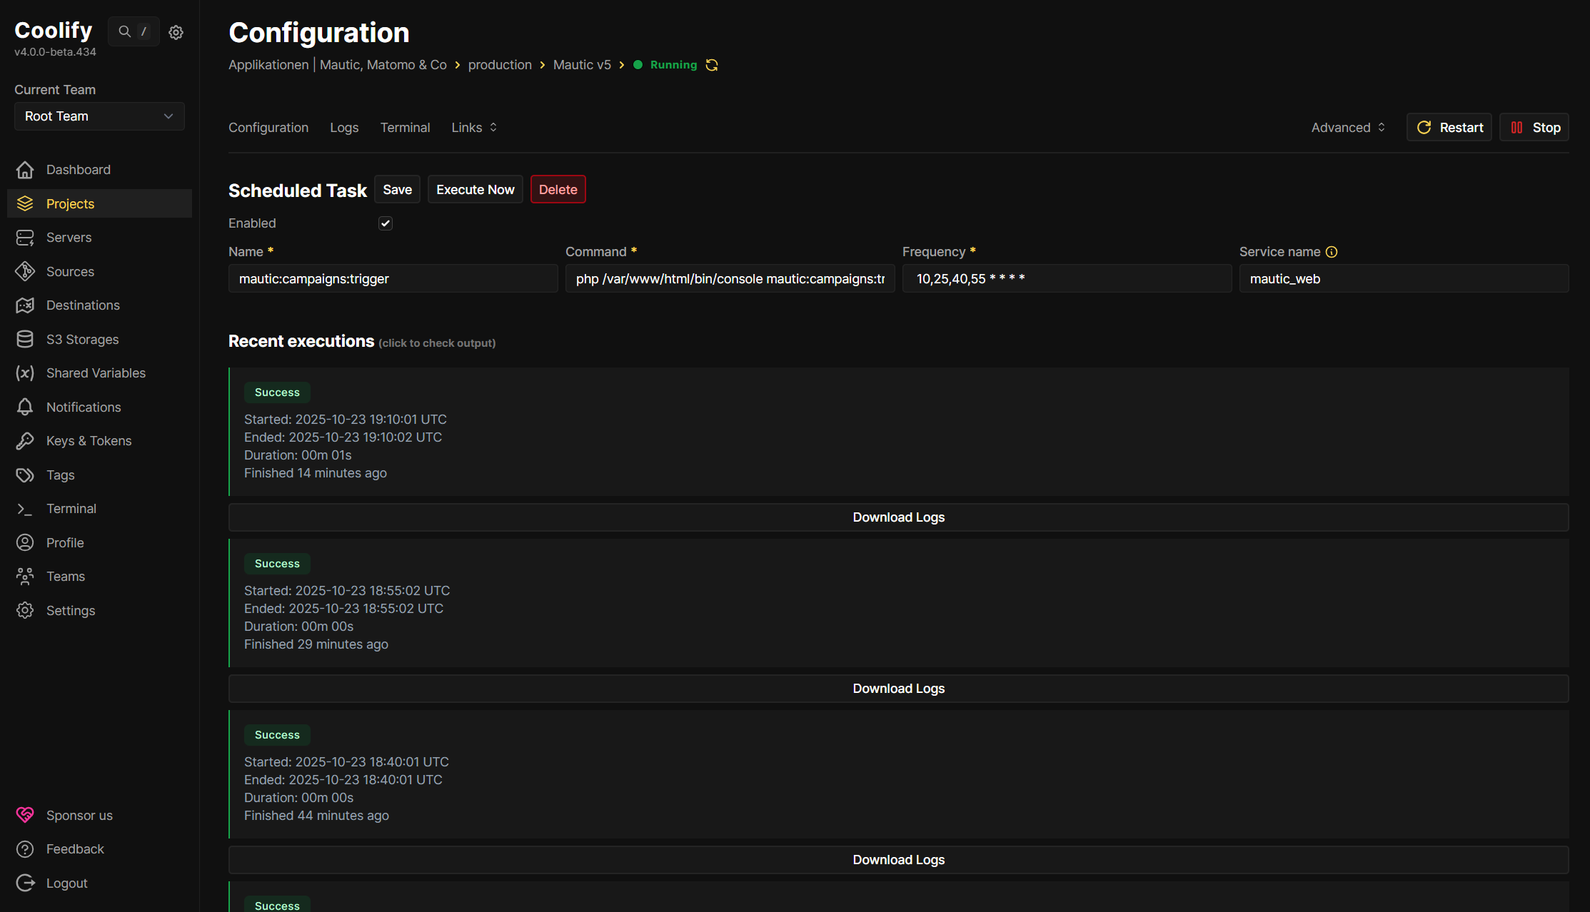
Better than cron?
Mautic World Conference 2025 @Sea Containers, London
9
Easy Web Interface Management Scheduled tasks created and edited directly in the browser. No SSH access or manual crontab editing
Execution History Visible Past task runs are automatically logged. Shows status, timestamp and duration of recent executions
Automatic Failure Notifications Failed tasks trigger notifications. If a Mautic command fails, you know immediately
Download Log Files Output of each execution is stored persistently. Logs can be downloaded directly from the interface as files
Container Integration Without Workarounds Tasks run directly in the Mautic container. No separate cron container configuration or volume mounting for cron files

Slide 11
How to Deploy in coolify
Mautic World Conference 2025 @Sea Containers, London
10
Two viable options…
… to start without the One Click* Installer
* A viable option if you need queueing

Slide 12
Directly use a compose file
Mautic World Conference 2025 @Sea Containers, London
11
Option 1: How it works
When would I use that again?
Copy
Copy your docker-compose.yml to Coolify UI
Configure
Configure Environment Variables, URL, Service Name, Description
Configure Scheduled Tasks, potentially Webhooks
Deploy
Click deploy - Coolify pulls images and starts containers
Update
Updates require manual file edits and redeployment
Testing and experimentation
Quick iterations without Git overhead or setting up a GitHub App (to me the most painful part anytime I need to do that)
Single instance deployments
Just one Mautic setup to manage
Simple configurations
No need for version history
Learning Coolify
Easiest way to get started
One-person show
You're the only one touching this setup

Slide 13
Git Ops is your friend
Mautic World Conference 2025 @Sea Containers, London
12
Option 2: How it works
When would I use that again?
Push
Push your docker-compose.yml to a GitHub repository
Connect
Connect Coolify via GitHub App integration
Deploy
After the initial deployment, every push to main branch triggers automatic deployment
Stage
You can easily create a staging setup with a separate branch
Update
Each and any push (or merge) into main triggers an automated deployment
Production environments
If you need an audit trail and reproducibility this option is your friend
Multiple environments
Easy and identical config for stage and prod environments (or with a bit more effort for multiple tenants/domains)
Team Collaboration
Multiple people working on the setup
Configuration as Code
Everything is beautifully versioned and documented.
Backup and disaster recovery
Your infrastructure is already backed up in Git

Slide 14
Is that all there is?
Mautic World Conference 2025 @Sea Containers, London
13
One more thing…

Slide 15
Going One step further
Mautic World Conference 2025 @Sea Containers, London
3
Plugins
Updates
Backups
Custom Dockerfile Setup plugin import in custom Mautic dockerfile
Working on Filebrowser Solution Setup filebrowser/filebrowser in coolify
Point to shared (plugin) volume
Start in UI when needed for plugin upload
Shut down to minimize surface area afterwards
Install Install plugin via Mautic UI
I haven’t done Mautic updates with this setup yet
Will probably be reporting on hat next year
;-)
Overall Coolify DB auto backuped every night
Run DB backups regularly
Create a playground for test-deploying with backup data and config
Optionally: Use Hetzner auto backup (+20% cost)

Slide 16
Results
Mautic World Conference 2025 @Sea Containers, London
15
6 month without a hickup Solution is now running smoothly for > 6 months
Easy two container setup Reduced complexity, great performance
Inspiration for next iteration My next iteration will definitely contain an upload capability for plugin files*
Never had less trouble with hosting I have never slept better when hosting for clients (or myself actually)
Happy wifeclient, happy life Client is happy and I can focus on helping them grow their business
* If Mautic doesn‘t gain the file upload capability for plugins like with themes

Slide 17

Questions?
Thank you!
Code Repo & Documentation
Github: /moorwald/mautic-world-conference-2025-hosting-mautic-on-coolify

